Slide 1


Enterprise Messaging Solutions

Slide 2




About sendQuick
Founded in 2001, delivering Enterprise messaging solutions for 19 years
Fully developed by sendQuick internal technical team, ensuring consistent technical support to all customers
Focus mobile messaging for all enterprise including SMS, mobile app messaging and social messaging platforms
Successfully implemented in more than 40 countries worldwide with more than 2000 Installations

Slide 3
Global Customers
United Kingdom, France, Switzerland, Netherlands, Norway, Sweden, Ireland, Austria, Spain, Denmark
USA, Canada
United Arab Emirates, Kingdom of Saudi Arabia, Bahrain, Lebanon, Oman
Singapore, Malaysia, Hong Kong， Macau, Indonesia, Taiwan, China, Thailand, Vietnam, Brunei, Philippines, India, Sri Lanka, Korea, Myanmar, Japan, Cambodia
Egypt, Maldives, Rwanda
Our Clients
Australia, NZ
© Copyright 2020. TalariaX Pte Ltd. All Rights Reserved.

Slide 4
Partners and Distributors Network
UK
Netherlands
China
Korea
USA
France
Japan
UAE, Saudi Arabia
Hong Kong
Taiwan
Thailand
India
Philippines
Malaysia
Vietnam
Singapore
Indonesia
Australia
Offices
Partners & Distributors
© Copyright 2020. TalariaX Pte Ltd. All Rights Reserved.

Slide 5
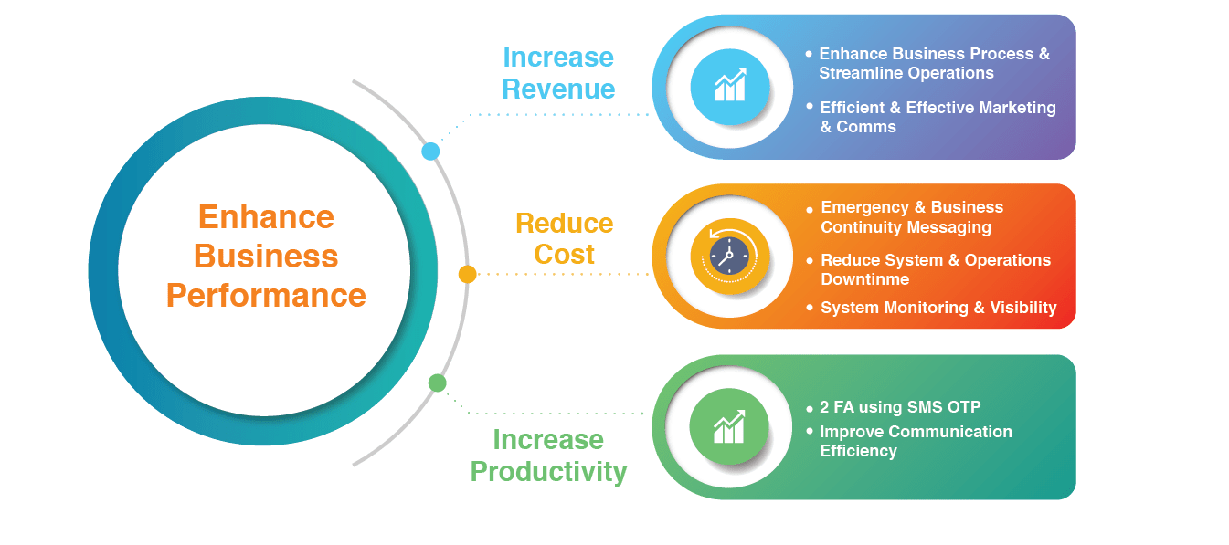
We Help You

Slide 6






Products
Suggested
Industries:
Financial Institutions, Governments, Service based companies, Data Centers, others
Any organizations with critical operations that cannot afford to have system downtime
Healthcare, Education, Hospitality, Manufacturing, Shipping, Financial, others
Key Features
Support Messaging Filters for SMTP (Email), SNMP Traps and Syslog
Built-in SMS reminder and escalation features to ensure message acknowledgement
Supports system monitoring (Ping) with SMS alert to ensure server availability
Built-in SMTP email gateway and email relay function to relay email alert messages and serves as a back- up email gateway for the enterprise
Unlimited web user access rights with customizable access rights
Support Email, SNMP Traps and Syslog with PING, Port and URL check for IT alerts
Automatic SMS message routing (Using SMS keyword) for interactive information on demand
API Integration to any applications (HTTP Post, XML, JSON, JDBC, FTP)
Pay per use
Fast SMS delivery (2 SMS per sec)
2 way messaging (Long Code & Short Code)
Web broadcast and API for application integration
Customizable Caller ID can be used for branding purposes
Low setup and monthly fee

Slide 7
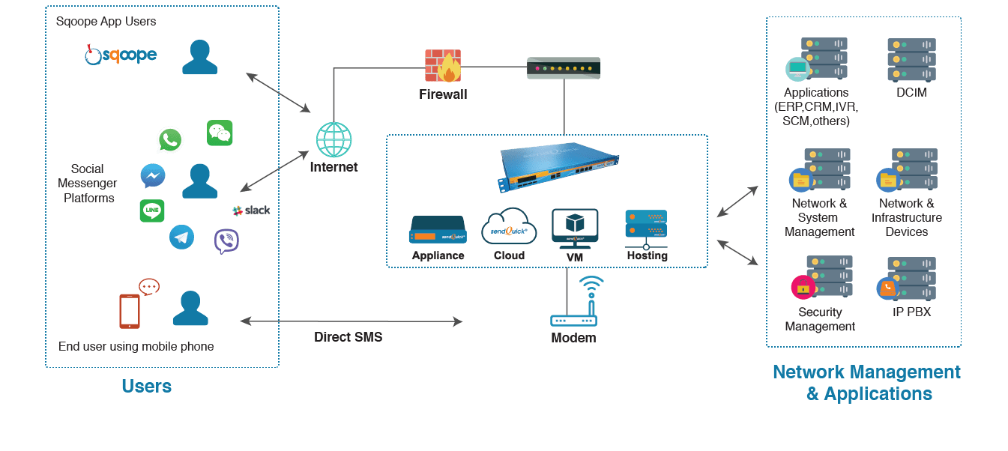
sendQuick is the Central Enterprise Messaging system delivering messages to all mobile devices

Slide 8
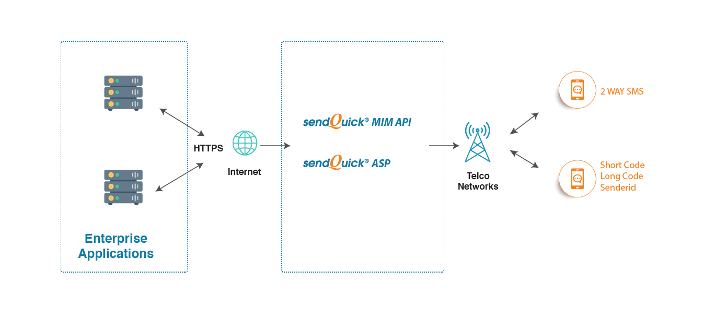
sendQuickASP Cloud Network Overview

Slide 9
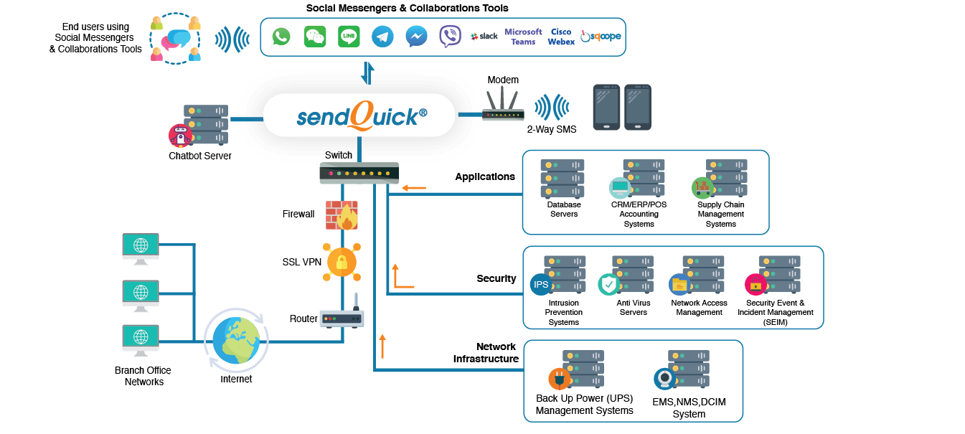
Implementing sendQuick (Network View)

Slide 10








Key Benefits
Good ROI
Quick & Simple Integration
Centralized Messaging gateway for all messaging types (SMS, social). Can be used for any applications
Open API (application interface) allows sendQuick to be easily integrated to all types of applications
Easy to install
Increased Interactivity
Plug-and-play. Simple!
Supports 2-way messaging on any phone and networks
Lower Total Cost of Ownership
Highly Flexible
Unlimited User License
Customizable. Choice of sending SMS (modem or direct connection), social, App, with optional modules
Support unlimited user, application, device and messaging license
High Messaging Reliability
Highly Scalable
Modem scalability (32 modems) and High Availability (HA)
Hardened system with built-in SMTP (email) servers. Direct sending using SIM eliminates Internet issues. Social Messaging with route-back for greater reliability

Slide 11















Fulfilling All Enterprise Requirements
Security Systems
Firewall • Load Balancer • Anti-virus • SIEM/IPS
Infrastructure Monitor
Environment Monitor • Ups/Back-up Power • Cable Management
APPS &
Database
• ERP • Point-of-sale • CRM
• Call Centre • Supply Chain
Remote
Access
PAM_RADIUS
Network Monitor

Slide 12


Finance, Banking and Insurance
IT notifications for system issues
SMS for helpdesk
SMS for marketing & promotions
SMS for credit card services (late payment, fee waiver)
SMS (incoming) sales enquiry on financial services
SMS OTP for authentication
SMS enquiry and customer notifications

Slide 13


Healthcare
SMS for Appointment Reminders
IT alerts and systems issues
Secure remote access OTP for regulatory compliance
Helpdesk and Call centres applications
Lab reports and test updates SMS
SMS for Hospital Management

Slide 14


Construction & Real Estate
SMS for IT notifications
Job dispatch with 2-way acknowledgement
Reminders on important schedules
Project management milestone checking
Facility Management
Project reporting with SMS
Sales & Marketing

Slide 15


Hospitality (Hotel & Tourism)
SMS for IT alerts for system issues
Transaction confirmation (reservations and reminders)
Marketing & promotions
SMS for helpdesk
Concierge and front desk usage
Notifications for equipment and building monitoring
WiFi Password or OTP

Slide 16


Retail, Food & Beverage
SMS for marketing & promotions
IT alerts for important systems
Loyalty points SMS integrations
Reminders for promotions and members’ activities
Reminders for customers for e-commerce transactions
Integration to ERP and CRM systems
User subscriptions/unsubscriptions

Slide 17


Government
IT systems alert complementing system and security monitoring
2FA for secure remote access
Reminders for public service delivery
Transaction status requests using SMS
Notifications for transactions and status updates
Public notifications for emergency messages

Slide 18


Logistics & Manufacturing
SMS for job dispatch with 2-way confirmation
Reminder for staffs and customers
SMS for facility management
SMS for IT alerts for system issues
Integration to business process for critical process notifications
Transaction status for customers
Marketing & promotions

Slide 19


Education
IT systems monitoring and alerts
Reminders for students for fees and assignments
2FA for remote access for education resources
Notifications of change of class
Notifications for student matters
Notifications to parents on students issues
New classes/courses availability

Slide 20


Computer, Internet and IT service
IT alerts for system issues
Data center monitoring and alerts
2FA for secure remote access using SSL VPN
Security alerts with SIEMs and others
Job dispatch with acknowledgement
Issues reminders and escalations
Helpdesk dispatch and notifications

Slide 21
Return on Investment (ROI) for IT Notification
Based on the following assumption:
Sales Turnover: S$20 million (per annum)
One hour of system downtime will cost:
Business Days: 260 days (per annum)
Loss of Revenue:
S$7,700 (per hour)
Employee work loss:
S$5,000 (per hour)
Total Loss (per hour):
S$12,700
Business Hours: 10 hours (per day)
No. of Employees: 200 employees
Employee Cost: S$25 (per hour)

Slide 22
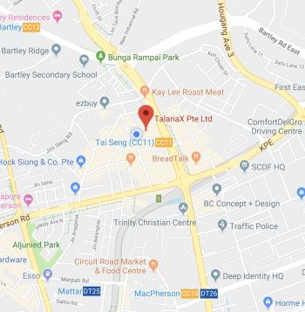
Contact Us!
TalariaX Pte Ltd
76 Playfair Road, #08-01, LHK 2 Building, Singapore 367996
+65 6280 2881
+65 6280 6882
info@talariax.com
www.talariax.com

